Slide 1
Common Security Issue Of J2EE Application

Slide 2
Agendia
SQL Injection
Directory Listing
Clear Password Transmission
Cross Site Scripting
Password Auto-completion
Not Cleared Session Data
Sensitive Parameter Of Get Requests
Not Changed Session ID After Login

Slide 3
SQL Injection
Introduction
  If a parameter come from client side is used to construct SQL dynamically, illegal SQL would be executed.

Slide 4
SQL Injection
Scenario
  The system use below SQL for authentication. ({userId} and {pwd} are string parameters come from client side)
  select * from table_name where user_id = ‘{userId}’ and password = ‘{pwd}’
  If the value of {userId} is “’ or 1=1 --”, the SQL would be:
  select * from table_name where user_id =‘’ or 1=1 -- and passowrd = ‘’
  The system can be logged in with any account without password.

Slide 5
SQL Injection
Solution
  Always use prepared statement for dynamically SQL:
  // prepare a SQL with ?
  PreparedStatement pstmt = conn.prepareStatement(…);
  …
  pstmt.setString(1, …); //insert the parameter with setXxx() method
  pstmt.setString(2, …);
  …
  pstmt.execute(); //execute SQL

Slide 6
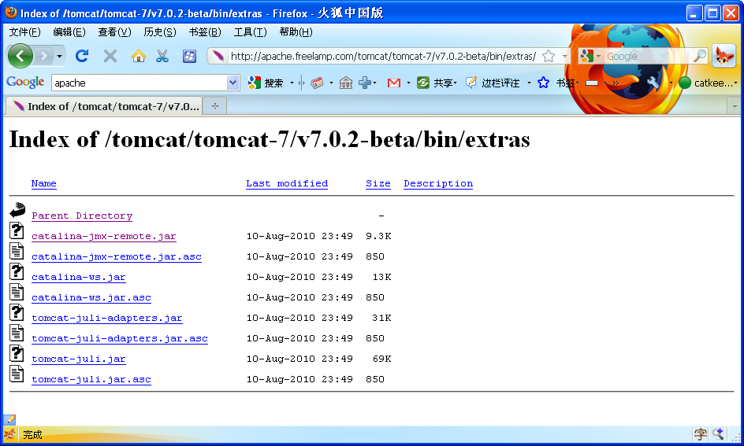
Directory Listing
Introduction
  Some web servers allow directory listing as below:
  It may be an issue, if any sensitive files are displayed in the listing.

Slide 7
Directory Listing
Solution
  Disable the listing function of web server
  Put all sensitive files in WEB-INF folder of your web application
  Implement a filter serverlet that block all http requests that access your sensitive files.

Slide 8
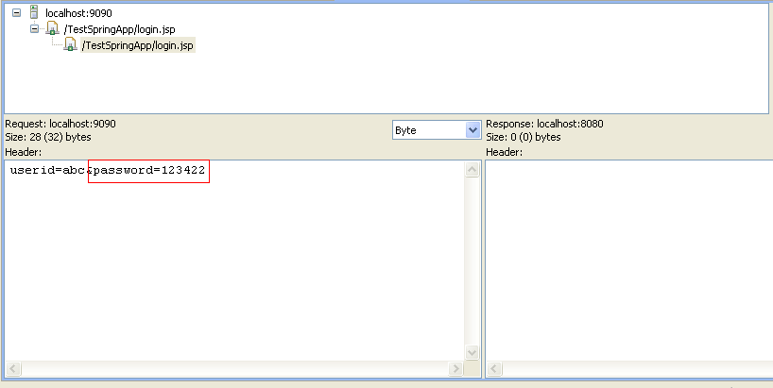
Clear Password Transmission
Introduction
  Password would be steal if it is transmitted in clear text over the internet.

Slide 9
Clear Password Transmission
Solution
  Always use HTTPS

Slide 10
Cross Site Scripting
Introduction
  If the application does not escape special characters in the input/output and reflects user input as is back to the browser, an adversary may be able to inject script to the web page.

Slide 11
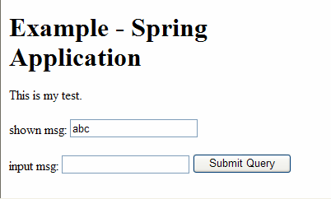
Cross Site Scripting
Scenario
  Below is an JSP. When the submit button is clicked, the value in “input msg” would be submitted to current page and displayed in the “shown msg” field.
  The source that print the value of “msg” in “shown msg” field.
  shown msg: <input type="text" value="${msg}"/>

Slide 12
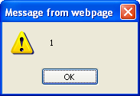
Cross Site Scripting
Scenario(Continue)
  If you type “"/><script>window.alert(1)</script> <input” in the “input msg” field, “1” will be prompted. That means a javascript statement has been injected successfully.

Slide 13
Cross Site Scripting
Solution
  Use <c:out/> tag of JSTL to print all dynamical value.
  The source should be adjusted as below:
  shown msg: <input type="text" value=‘<c:out value="${msg}"/>’/>

Slide 14
Password Auto-completion
Introduction
  Browsers have a feature to remember the recently typed web addresses, web form entries, user name and passwords. When a user starts typing, the browser suggests possible matches. This feature is known as auto-complete. If auto-completed is enabled to remember passwords, then every time a user logs into the application, browser asks user to remember the password. If the user had accidentally clicked “Yes”, the a local adversary can login with the remembered password.

Slide 15
Password Auto-completion
Solution
  Make sure the “auto-complete” is disabled for password and other sensitive fields.
  <form autocomplete=“off”>
  <input type=“password” autocomplete=“off”>

Slide 16
Not Cleared Session Data
Introduction
  If session is not cleared when user logout and the session ID is included in the URL(when URL rewriting is used) of some pages, local adversary can resume the session by accessing the history function of browser.

Slide 17
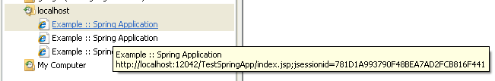
Not Cleared Session Data
Scenario
  Login an application.
  Access some pages that involve URL rewriting.
  Close the browser.
  Open the browser again and access the history function:
  The session would be resumed.

Slide 18
Not Cleared Session Data
Solution
  Always invalid the session when user logout.
  Specify timeout time for session in the web application server.

Slide 19
Sensitive Parameter Of Get Requests
Introduction
  If a form include some sensitive fields and this form is passed to server with GET method, adversary can access these sensitive fields from this history.

Slide 20
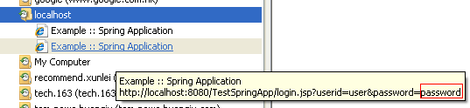
Sensitive Parameter Of Get Requests
Scenario
  If a user login an application and the login HTTP request is passed with GET method, the password can be retrieved from history.

Slide 21
Sensitive Parameter Of Get Requests
Solution
  Always use POST method in a form.

Slide 22
Not Changed Session ID After Login
Introduction
  hacker can hijack a session of other legal user if the application does not always create a new session ID for every logon

Slide 23
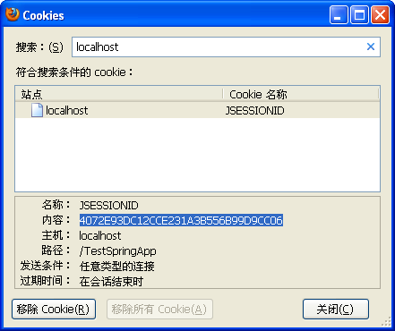
Not Changed Session ID After Login
Scenario
  The hacker login the application with his/her user ID and password.
  This hacker keeps his/her browser opening and retrieves the ID of his/her session. If firefox is used, he/she can do it by accessing “Tools” -> “Options” -> “Show Cookies”. In below picture, the session ID is “4072E93DC12CCE231A3B556B99D9CC06”.

Slide 24
Not Changed Session ID After Login
Scenario (Continue)
  This hacker sends below URL as a hyperlink to another legal user through email “http://testingserver:8080/TestApp/login.jsp;jsessionid=4072E93DC12CCE231A3B556B99D9CC06”
  When this legal user open the logon screen by clicking this URL and login with his/her account, the system will use “4072E93DC12CCE231A3B556B99D9CC06” to identify the session of the legal user.
  Now, the hacker and the legal user are using the same session ID. The hacker can access the application with the legal user’s account.

Slide 25
Not Changed Session ID After Login
Solution
  Always create new session when user login.
  // check is there any session has been created
  HttpSession session = request.getSession(false);
  If(session != null){
  session.invalidate(); //if so, clear it
  }
  session = request.getSession(false); //create new session
  // save user ID or other user info into the session object.
  session.setAttribute(userId);

Slide 26
Q & A

